Slide 1
VC210 Quiz 2 Review
Gas, Liquid & Solid
Han Xu

Slide 2
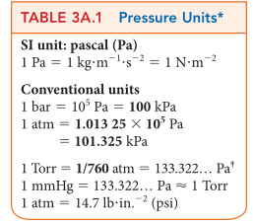

Unit of Pressure
1 Pa = 1$kg·m^{−1}·s^{−2}$
1 bar =${10}^{5} Pa$
1 atm = 1.01325*${10}^{5}$ Pa
760 Torr =760 mmHg =1 atm
Pay attention !

Slide 3
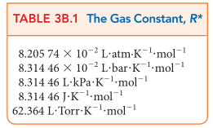
Ideal Gases
Ideal Gas Equation: PV=nRT
Unit of T: Kelvin
T(K)=T(C)+273
R: gas constant
You may use gas constant of different units to solve problem faster.

Slide 4
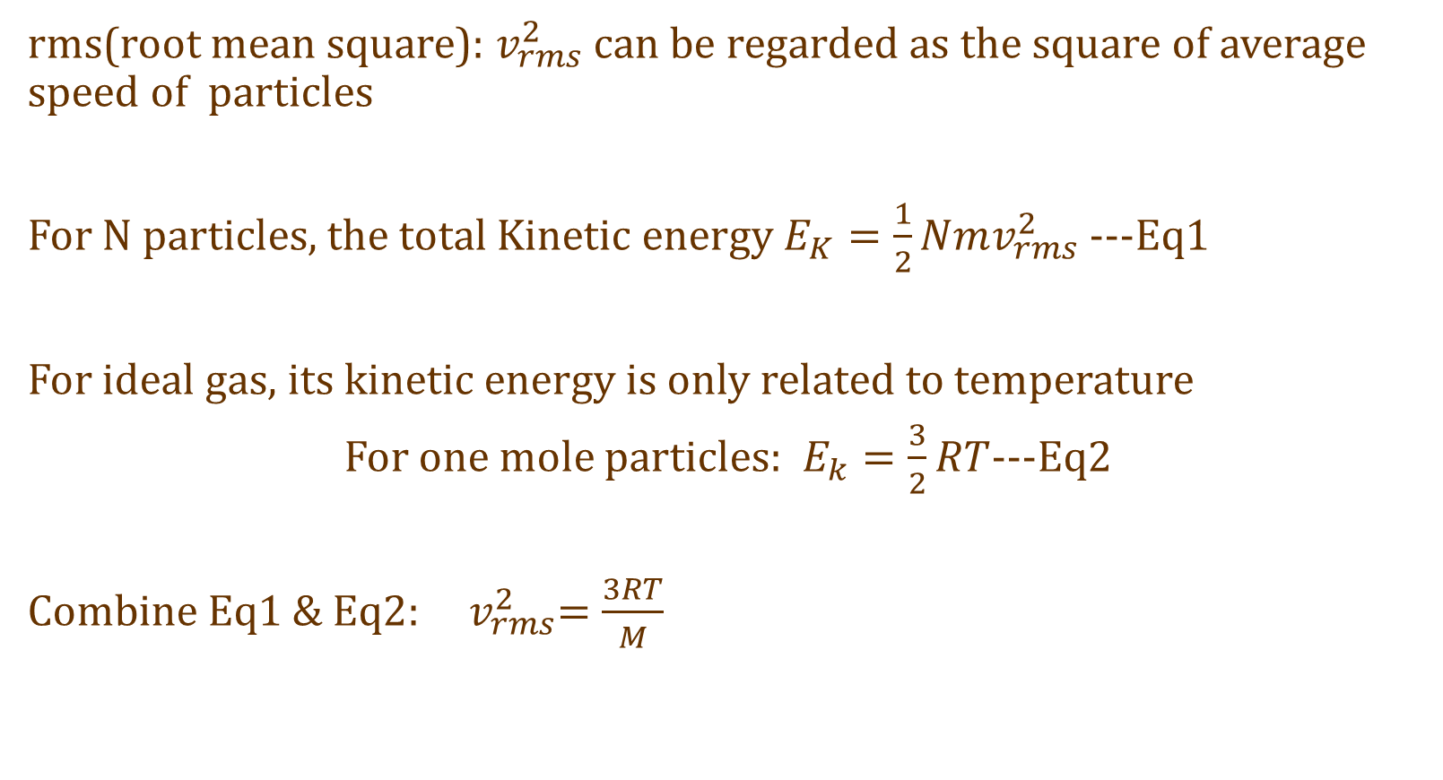
Ideal Gases- Concepts
rms(root mean square): $v_{rms}^{2}$ can be regarded as the square of average speed of particles
For N particles, the total Kinetic energy $E_{K}=\frac{1}{2}Nmv_{rms}^{2}$ ---Eq1
For ideal gas, its kinetic energy is only related to temperature
For one mole particles: $E_{k}=\frac{3}{2}RT$---Eq2
Combine Eq1 & Eq2: ${ v}_{rms}^{2}=\frac{3RT}{M}$

Slide 5
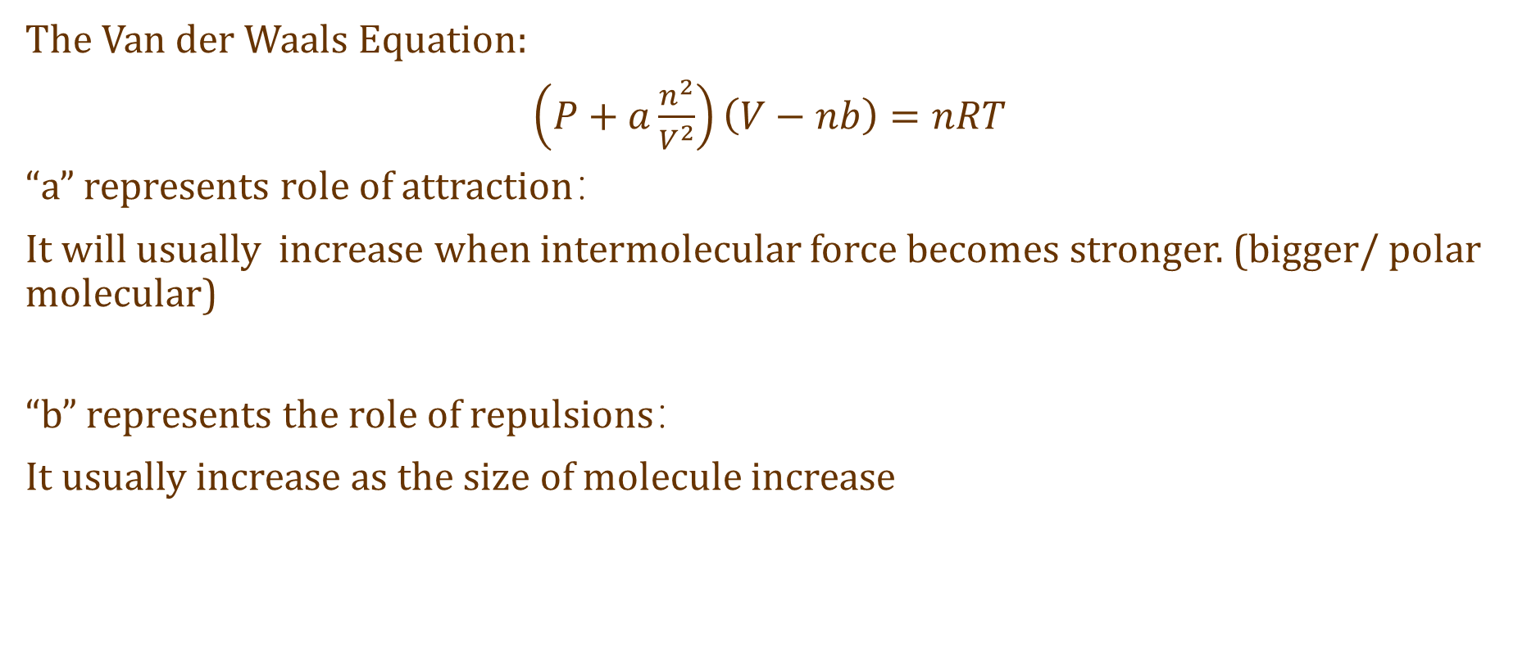
Non-ideal Gas
The Van der Waals Equation:
$\left(P+a\frac{n^{2}}{V^{2}}\right)\left(V−nb\right)=nRT$
“a” represents role of attraction：
It will usually increase when intermolecular force becomes stronger. (bigger/ polar molecular)
“b” represents the role of repulsions：
It usually increase as the size of molecule increase

Slide 6
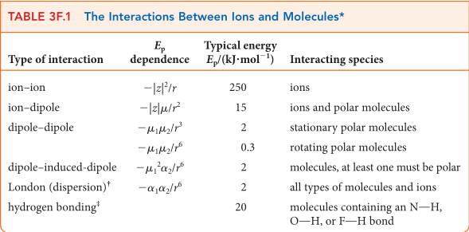

Intermolecular forces
Origin: Columbic interaction $E_{p}=\frac{q_{1}q_{2}}{4πε_{0}r}$
The strength (measured by potential energy $E_{p}$) is determined by q & r

Slide 7
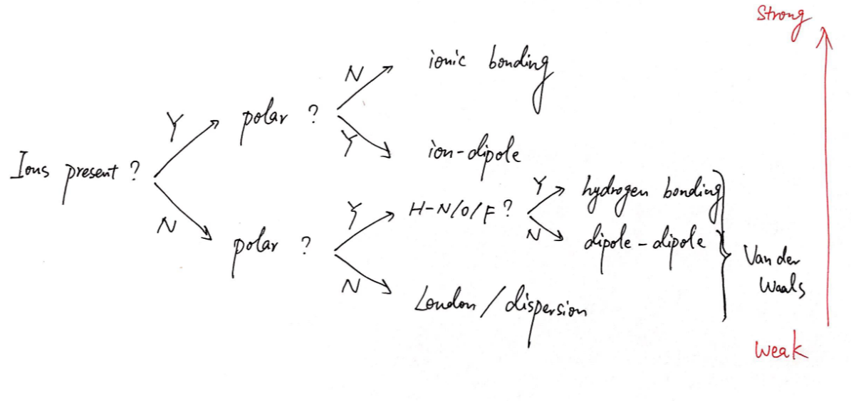
Intermolecular forces

Slide 8
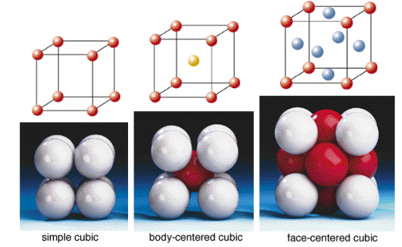

Unit Cell
The geometry relationship: Atom (ball in unit cell) is tangent to each other
face-centered cubic structure (fcc)
a=$2\sqrt{2}r$
body-centered cubic structure (bcc)
a=$\frac{4}{\sqrt{3}}$r
A primitive cubic
a=2r

Slide 9
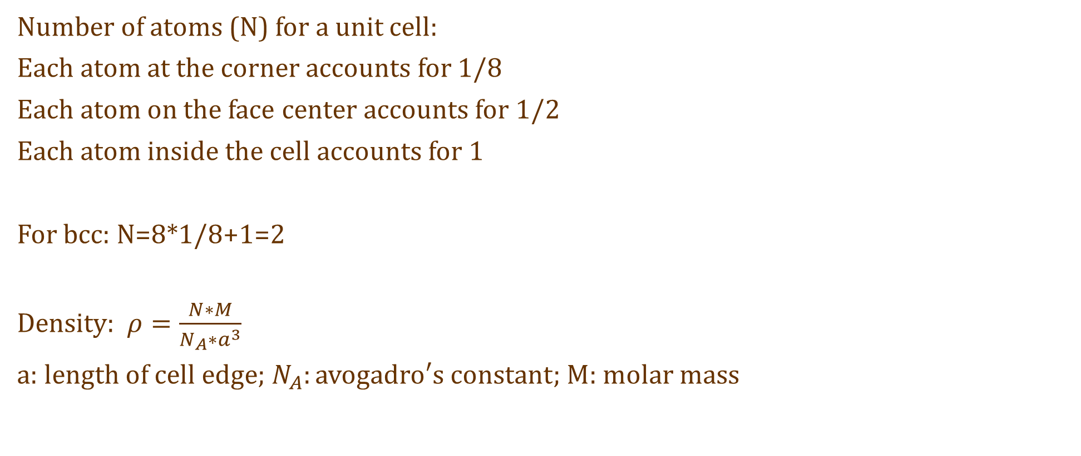
Unit Cell
Number of atoms (N) for a unit cell:
Each atom at the corner accounts for 1/8
Each atom on the face center accounts for 1/2
Each atom inside the cell accounts for 1
For bcc: N=8*1/8+1=2
Density: $ρ=\frac{N∗M}{N_{A}∗a^{3}}$
a: length of cell edge; $N_{A}:avogadro′s constant;$ M: molar mass

Slide 10
Don’t make stupid mistakes in calculation!
AND GOOD LUCK

